Slide 1


Online Banking Application
Presented By:
Raju Sarkar (229188)
Shaikh Arbaj Salim (229202)

Slide 2
Introduction
An Online Banking Application is designed to provide online banking services to customers. It involves the development of a web-based platform that allows users to perform various banking activities.
The main objective of an online banking project is to offer customers the convenience of accessing banking services anytime and anywhere they have an internet connection. This eliminates the need for physical visits to bank branches, allowing customers to manage their finances more efficiently.
Overall, an online banking project can help banks improve customer satisfaction, reduce costs, and increase revenue by providing an efficient and convenient online banking service.

Slide 3
Motivation
Online Banking Application provides customers with greater flexibility and convenience when it comes to managing their finances.

Slide 4
Objectives
Convenience: The primary objective of online banking is to provide customers with a convenient and user-friendly platform for accessing banking services. Customers should be able to perform various transactions through the online platform.
Efficiency: Online-banking aims to improve the efficiency of banking services by automating many processes, reducing the need for manual intervention, and enabling faster transactions. This can help banks reduce their operational costs and improve their overall productivity.
Accessibility: Online-banking aims to make banking services more accessible to customers who may not be able to visit bank branches due to physical disabilities or geographical constraints.
Innovation: Online-banking aims to foster innovation in banking services by enabling banks to introduce new products and services quickly and easily. The online platform should be flexible and scalable to accommodate new features and functions as required by changing customer needs and market trends.

Slide 5
Technologies Used
Front End: React
Back End: Java Spring Boot API
Database: MySQL 8.0.30

Slide 6
UML Diagrams

Slide 7
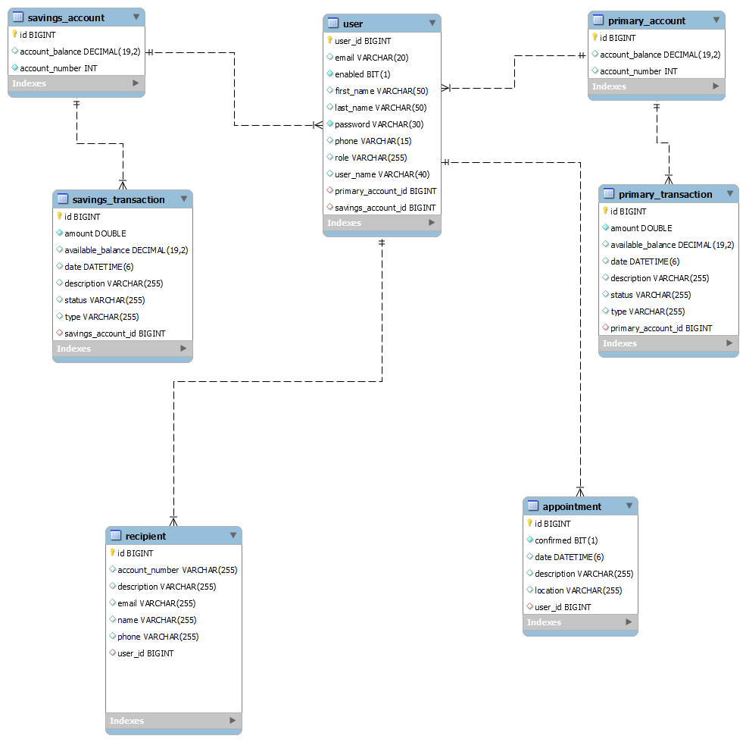
E-R Diagram

Slide 8
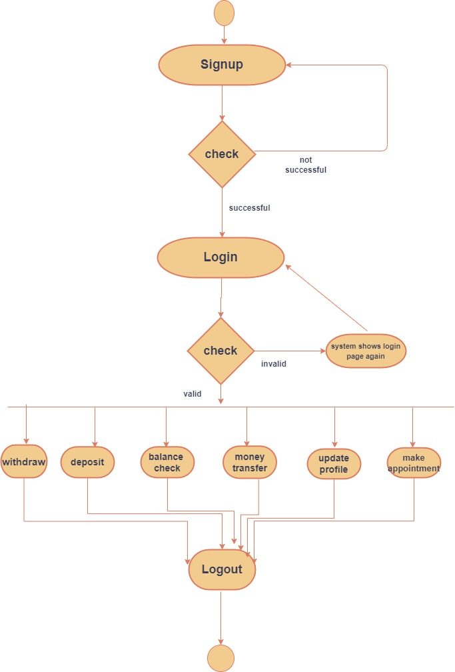
Activity Diagram of User

Slide 9
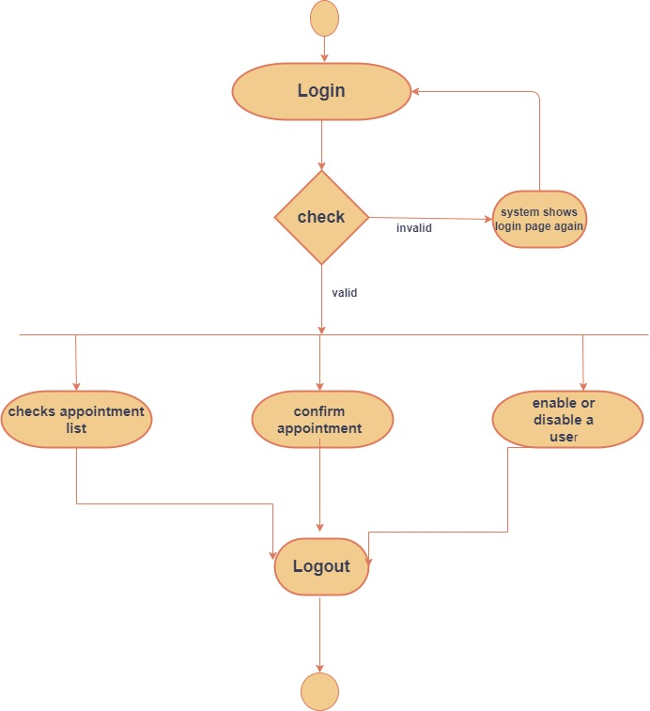
Activity Diagram of Admin

Slide 10
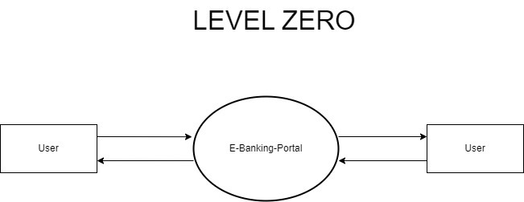
Data Flow Diagram
Level0:

Slide 11
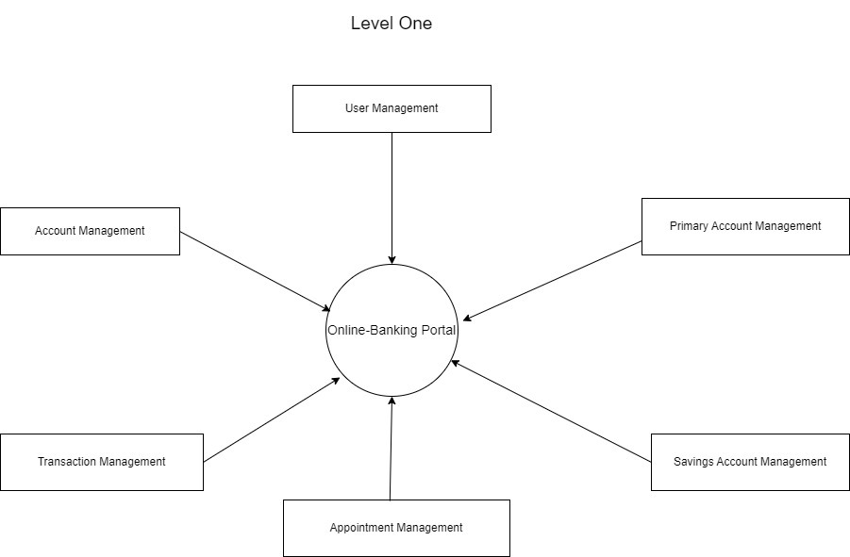
Level1:

Slide 12
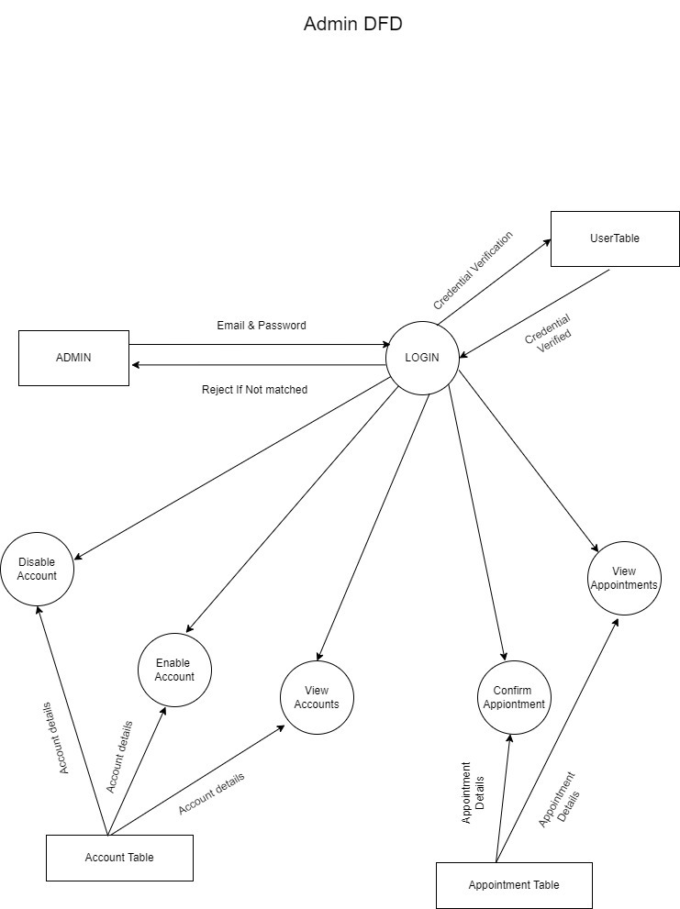
ADMIN Data Flow Diagram
Admin DFD:

Slide 13
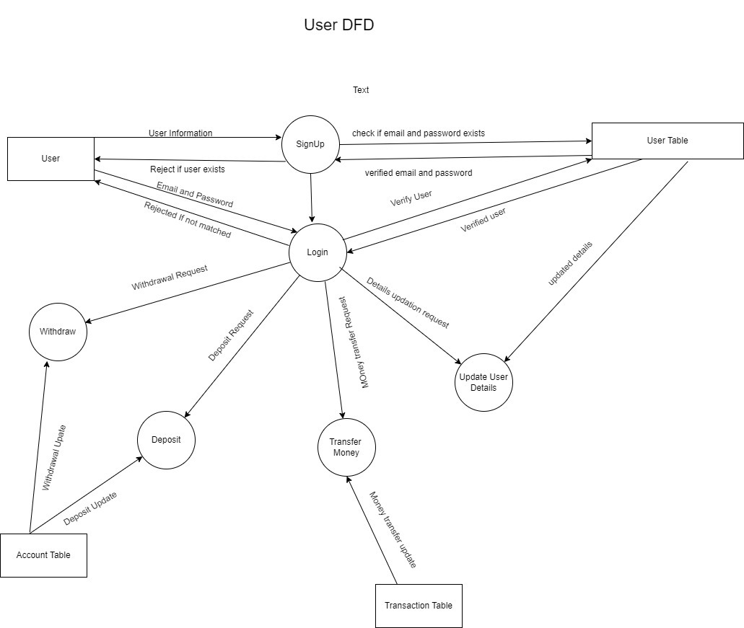
User Data Flow Diagram
User DFD:

Slide 14
Features of Online Banking Application

Slide 15
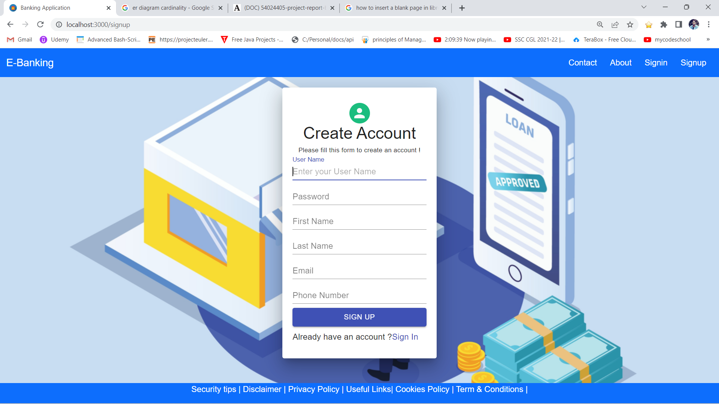
User SignUp

Slide 16
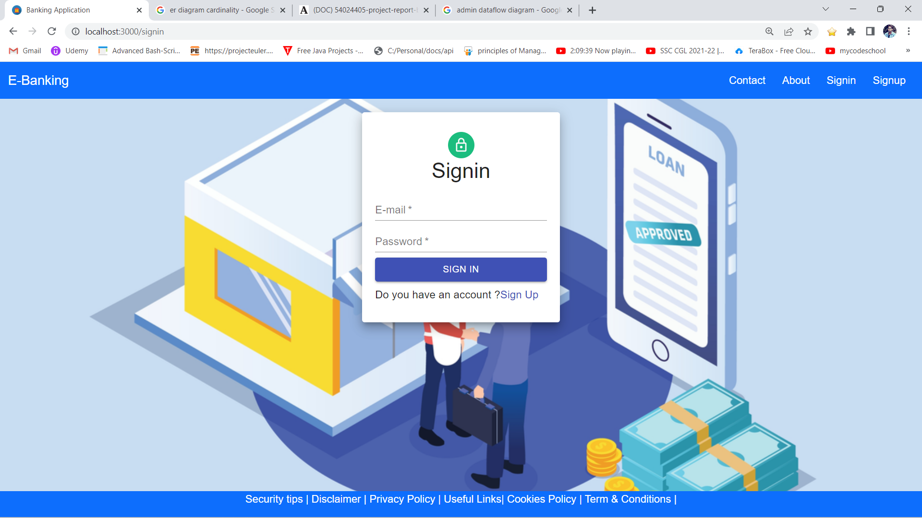
User Login

Slide 17
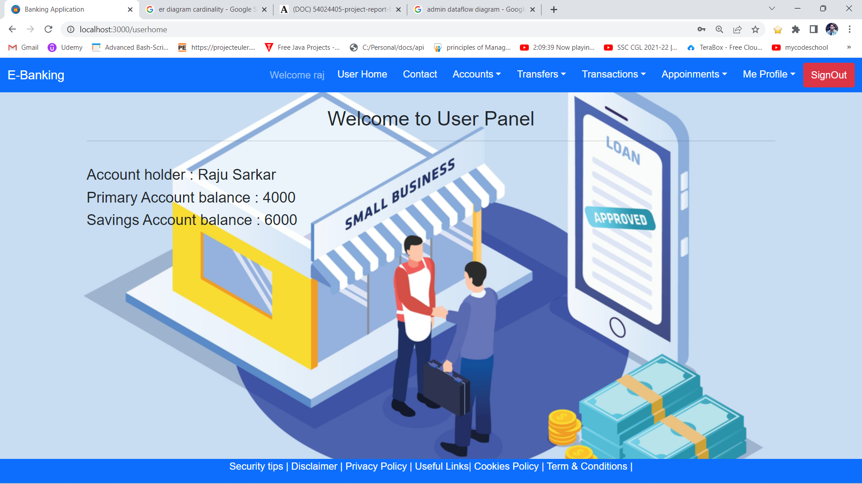
View Profile

Slide 18
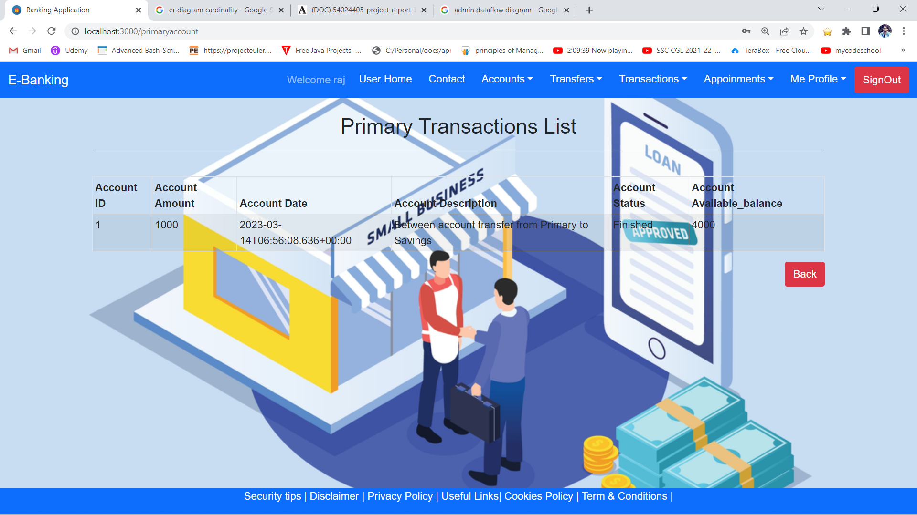
Transactions of User

Slide 19
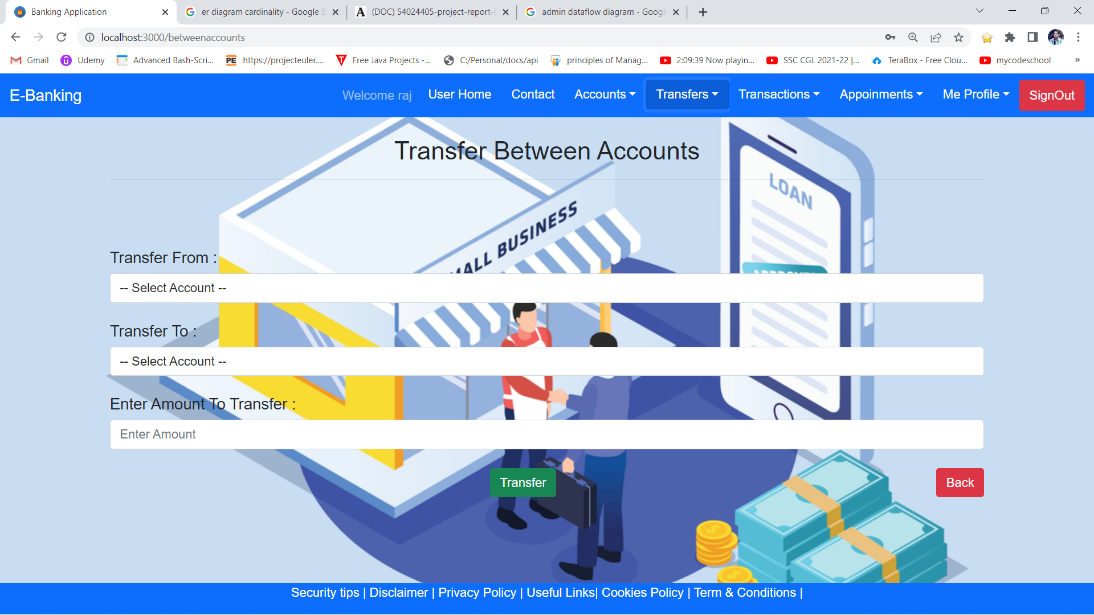
Transfer Funds Between Accounts

Slide 20
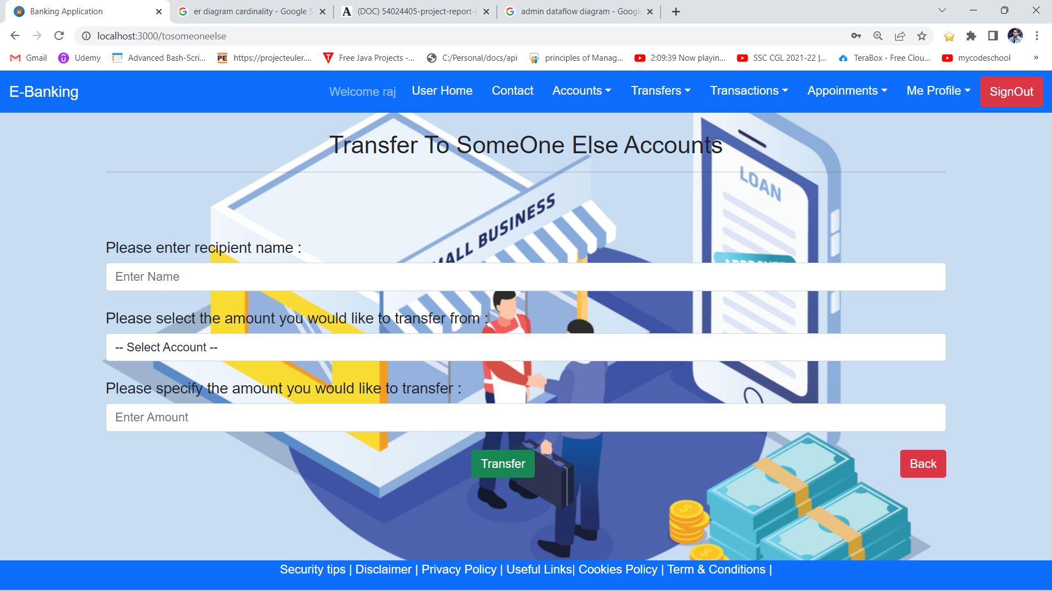
Transfer Funds To Recipients

Slide 21
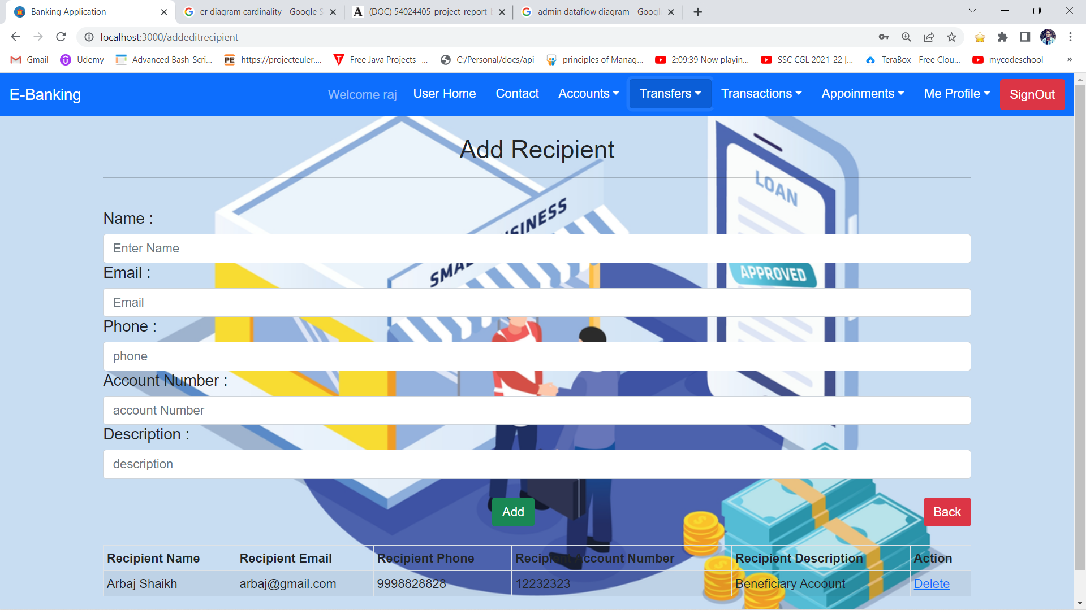
Add Recipients

Slide 22
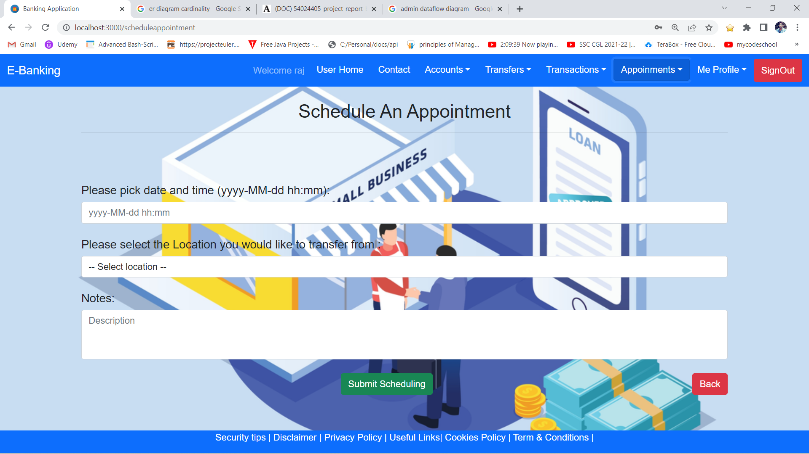
Schedule Appointments

Slide 23
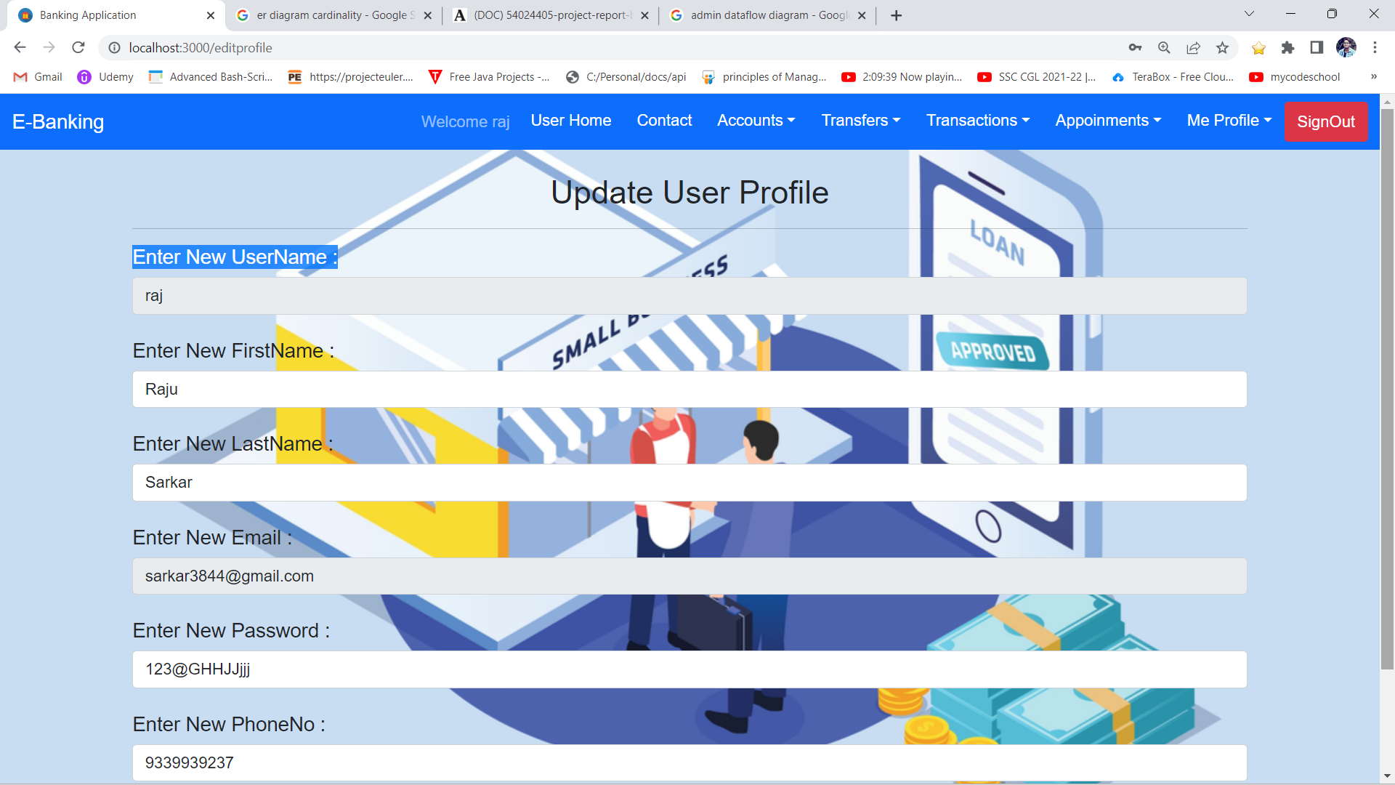
Update User Details

Slide 24
Specification
The application will use Spring-Boot and React as main web technologies.
HTTP is used for communication between clients and servers over the internet
Several types of validations make this web application a secured one and SQL Injections can also be prevented.
Since Online Banking is a web-based application, internet connection must be established.
The Online Banking will be used on PCs and will function via internet or intranet in any web browser.

Slide 25
S/W and H/W Requirements
Server Side:
Processor: Intel® Xeon® processor 3500 series
HDD: Minimum 500GB Disk Space
RAM: Minimum 8 GB OS: Windows 10 or later.
Database: MySQL 8.0.30
Client Side (minimum requirement):
Processor: Intel Dual Core
HDD: Minimum 80GB Disk Space
RAM: Minimum 8GB
OS: Windows 10 or later.

Slide 26
Advantages
Convenience: Online banking allows customers to access their accounts and perform transactions from the comfort of their own homes or offices. This eliminates the need to physically visit a bank, saving customers time and effort.
Accessibility: Online banking allows customers to access their accounts and perform transactions 24/7, which is especially useful for those who work irregular hours or live far away from a physical bank branch.
Cost-effectiveness: Online banking reduces the need for a large number of physical bank branches, which can be expensive to maintain. This can lead to cost savings for both the bank and the customer.
Improved efficiency: Online banking can automate many banking processes, reducing the need for manual intervention and improving efficiency. This can lead to faster transaction processing times and fewer errors.
Environmental benefits: Online banking reduces the need for customers to drive to physical bank branches, which can reduce carbon emissions and help to protect the environment.
Overall, an Online banking project can provide a range of benefits to both banks and customers, making it a worthwhile investment for many financial institutions.

Slide 27
Disadvantages
Technical difficulties
Security risks
Lack of personal interaction
Fees
Limited access to cash

Slide 28
Conclusion
This project helps banks manage their operations efficiently and effectively. The system provides several benefits such as enhanced security, increased accuracy in transactions, real-time data access, and improved customer service. With the use of an e-bank management system, banks can reduce operational costs and streamline their processes, which in turn, can result in higher profitability. Additionally, this system allows customers to access banking services anytime and anywhere, making it more convenient for them. Overall, an e-bank management system is a valuable investment for any bank seeking to remain competitive in today's digital age

Slide 29
Future Enhancement
This project can be enhanced further by adding payment gateway integration:
Integration with Multiple Payment Gateways, Seamless Payment Processing, Enhanced Security, International Transactions.
The software is flexible enough to be modified and implemented as per future requirements

Slide 30
References
https://docs.spring.io/spring-boot/docs/current/reference/htmlsingle/
https://www.w3schools.com/
https://javaee.github.io/javaee-spec/javadocs/
https://www.javatpoint.com/java-mail-api-tutorial
https://reactjs.org/docs/getting-started.html

Slide 31
THANK YOU

